Slide 1
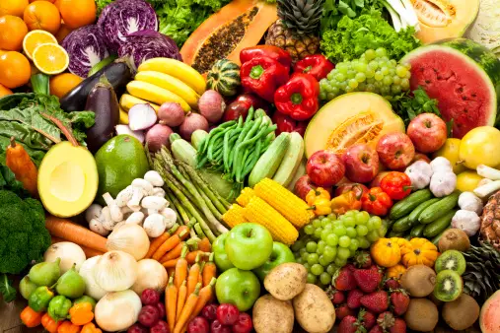

NAIVAS FRUITS AND VEGETABLES
SURVEY ANALYSIS
Prepared by Moreen

Slide 2
Background
quantitative study that was conducted by the business to assist in understanding consumer experience at the Fruits & Vegetables section.
The data was provided by respondents through a face-to-face survey in December 2022.
The respondents were both male and female shoppers.

Slide 3


Demographics Gender Total interviewed Respondents -420
Out of all the interviewed respondents 66.9% were female and 33.1% were male.

Slide 4
Age Brackets
From all the interviewed respondents
It is clear most fruits and vegetables
Shoppers lie between 25- 44 years
Old.

Slide 5
Monthly House hold income
Most respondents were not willing to answer how much they make. For those who answered majority of them had a monthly income of 15000 and above

Slide 6
Purchase Frequency
Most of the respondents shop daily and multiple times a week.

Slide 7
Branch Preference
All the branches are equally popular with Waterfront leading with a small margin.

Slide 8
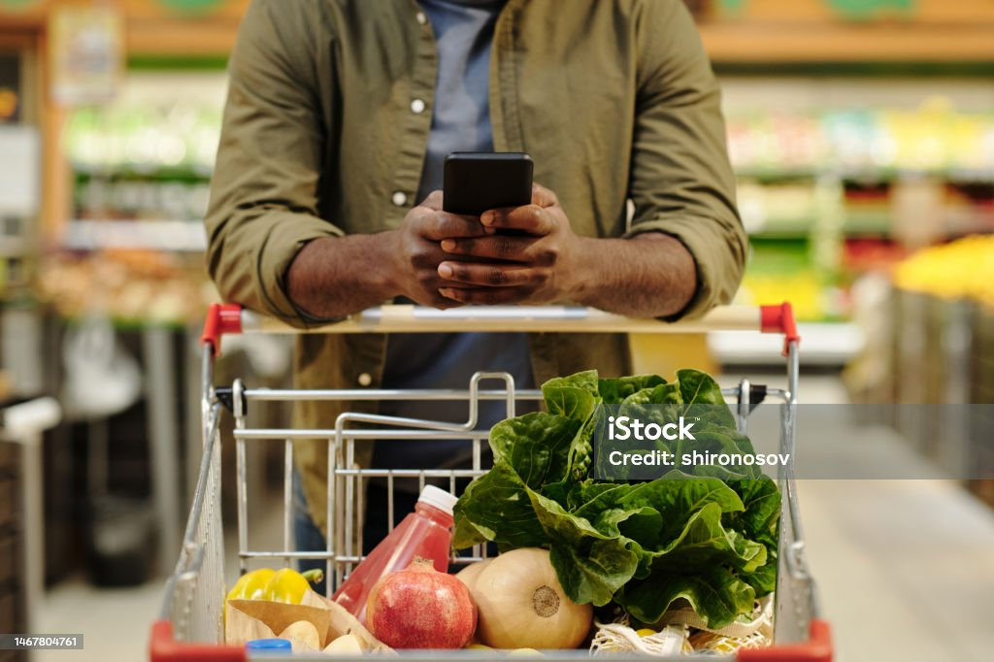
Shopper Behavior

Slide 9
Important Shopper Factors
From the data Quality Freshness price, Variety of products to choose from are the most important. Price on the other hand around 10% of the people thought it was not important.
When considering where to buy fruits and vegetables, please rate the importance of the following factors:

Slide 10
Naivas Satisfaction Factors
Looking at these our customers are quite services with Quality freshness etc. Price how ever is something to be looked into.
Looking back at your fruits & vegetable shopping at NAIVAS, in the last three months, how satisfied are you with the following aspects of fruits & vegetables at NAIVAS {0}?

Slide 11
Unsatisfaction Reasons
Below are some of the verbatim from the unsatisfied customers.
Bananas that never ripen but rot!
Tomatoes have pesticides

Slide 12
AWARENESS, USAGE & DRIVERS

Slide 13
Below are some of the competitor outlets with Carrefour leading in both categories.
Apart from Naivas, from which other stores/places have you bought fruits and vegetables in the past 3 months?
From the stores/places shopped at, which ONE do you most prefer when buying fruits and vegetables?

Slide 14
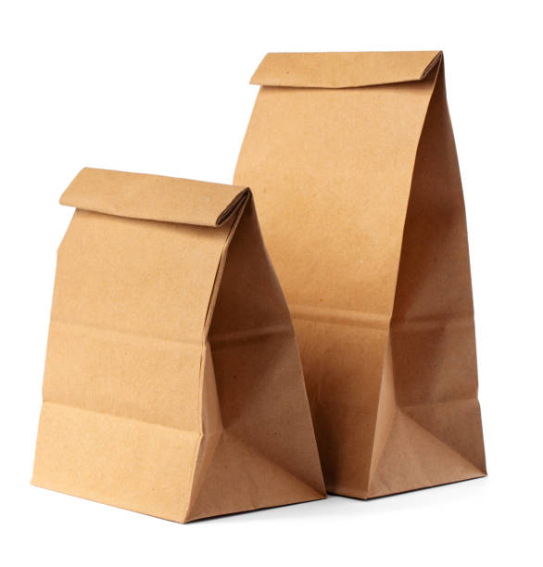
Respondents shopping for fruits & veggies in NAIVAS Kilimani

Slide 15
Packaging bags Popularity
Mesh nets and brown bags are the most used packaging bags by the respondents. On the other hand prepacked products are not that popular.
72% of the customers are satisfied with the brown packaging bags
Which of these packaging bags have you used when shopping for fruits &amp; veggies in NAIVAS Kilimani?
On a scale of 1-5, how satisfied are you with our new Brown packaging

Slide 16
Brown bag satisfaction
Around 75% of the customers are satisfied with all the aspects of the brown bags.
On a scale of 1-5, how satisfied are you with the new brown bags with regards to the following aspects:
:

Slide 17
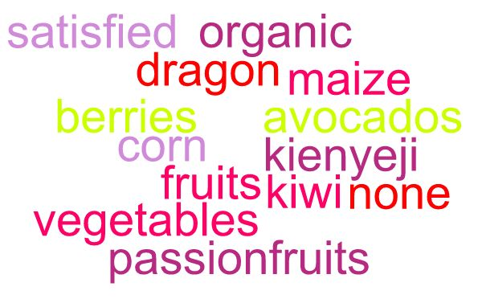
More Fruits and Vegetables
168 respondents did not propose any specific fruits and vegetables to added to the assortment at Naivas while 107 respondents were satisfied with the available fruits and vegetables. 32 other respondents requested addition of kienyeji organic vegetables specifically ( managu, Kunde, kahorora, among others). 6 requested dragon fruits, 6 corn, 8 kiwi, 4 avocados, and 3 berries.

Slide 18
Improvements
Most customers are happy with the Naivas experience but would like to see improvements In the speed of customer service variety and prices.
Kindly inform us on what to improve to make your experience better while shopping for fruits &amp; vegetables

Slide 19



NPS
1
2
3
4
5
6
7
8
9
10
DETRACTORS
NEUTRAL
PROMOTERS
11%
57%
32%
73
The net promoter score for this customers is at 73

Slide 20
Recommendations
Do frequent Competition price analysis
Improve on the variety

Slide 21
Thankyou

